Slide 1

Azure DevOps
#AzureDevOps
https://azure.com/devops @AzureDevOps https://aka.ms/AzureDevOpsForum https://aka.ms/DevOpsBlog/

Slide 2





Azure DevOps offerings
Azure offers a number of DevOps services intended for making the working processes for companies faster and easier
Azure Boards is a planning tool. It helps to track the working progress, share ideas and report the updates.
Azure Board
Azure Pipelines is a cloud service for creating and testing any code project with a possibility to share it with other users. It provides a combination of continuous integration (CI) and continuous delivery (CD) tools.
Azure Pipelines
Azure Repos is s set of various tools for code management. It offers hosting with unlimited repositories and the possibility to review and share the written code.
Azure Repo
Azure Test Plans is a combination of manual and exploratory testing tools that allows developers to efficiently test their apps.
Azure Test Plans
Azure Artefacts represents a universal package repository. It facilitates the process of discovering, installation and publishing npm, NuGet and Maven packages.
Azure Artifacts
© Cognizant 2013

Slide 3











Advantages of Azure DevOps
Lower costs for users if compared with many other DevOps services
10
1
Full support for Scrum artefacts and processes
Much more intuitively clear and user-friendly interface in comparison to similar platforms
The simplicity of implementation and use
2
9
Features like shelveset creation, work item monitoring, and publishing the project database
No overhead management tasks, people keep focused on product development and it reduces work time
3
8
4
7
It offers an easy relationship between product backlog items, development tasks, and the source code changes
Full integration between test cases and pipelines
Pipelines is a powerful feature for allowing you to deploy to anywhere (cloud, on prem, etc.) You can secure your pipelines and track your artifacts with ease
5
6
SaaS platform - no infrastructure maintenance needed

Slide 4
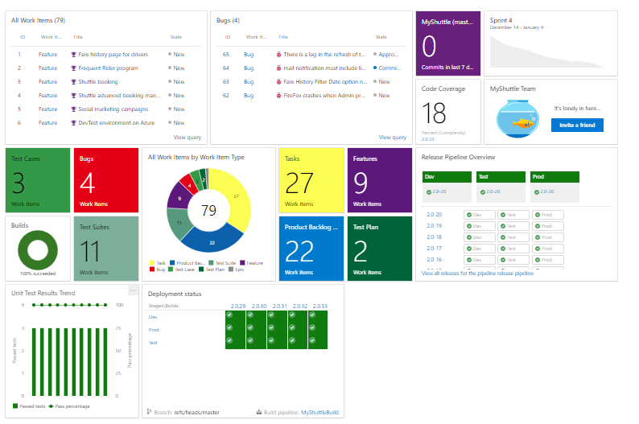
Azure DevOps Dashboard View

Slide 5
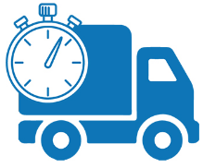






Azure DevOps - Key takeaways
Improved Quality of Service
Faster Time to Market
Improved Collaboration
Smart Operations
Improved System Availability
Zero Operational Error
Align to Agile Development Model

Slide 6
Thank You

